Slide 1
Objects In Javascript
ADACODE SOLUTIONS

Slide 2
Objects
It is a fundamental data type that allows you to store and organize data as key-value pairs.
Objects can represent real-world entities or abstract concepts and are used extensively in JavaScript programming.
Each value in an object is associated with a unique key, and you can access, modify, and delete values using these keys.

Slide 3
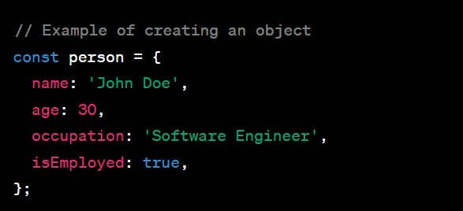
Creating an Object:
You can create an object in JavaScript using curly braces {} and defining its properties as key-value pairs.

Slide 4
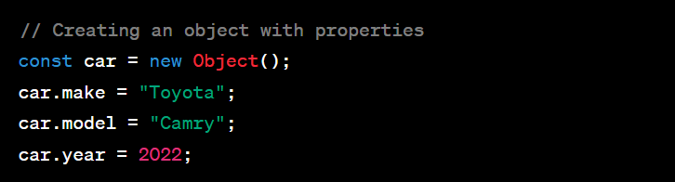
Using new keyword with Object constructor:

Slide 5
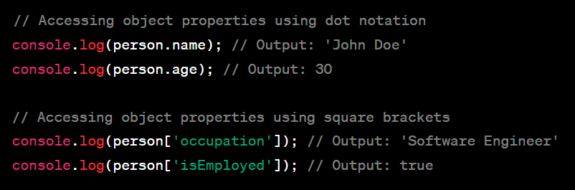
Accessing Object Properties:
You can access object properties using dot notation or square brackets.

Slide 6

Modifying Object Properties:
You can modify the value of an object property by assigning a new value to it.

Slide 7
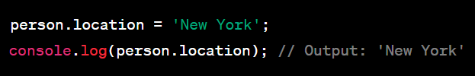
Adding New Properties:
You can add new properties to an object even after it has been created.

Slide 8
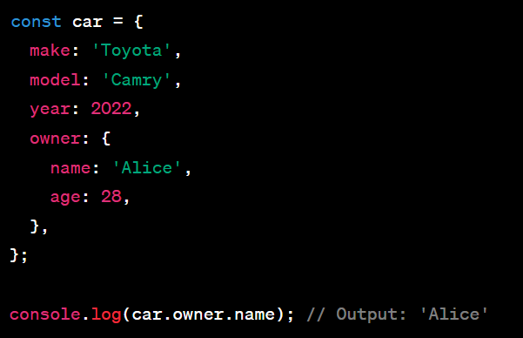
Nested Objects:
Objects can also contain other objects as properties, creating a hierarchical structure.

Slide 9

Deleting Properties:
You can remove properties from an object using the delete keyword.

Slide 10
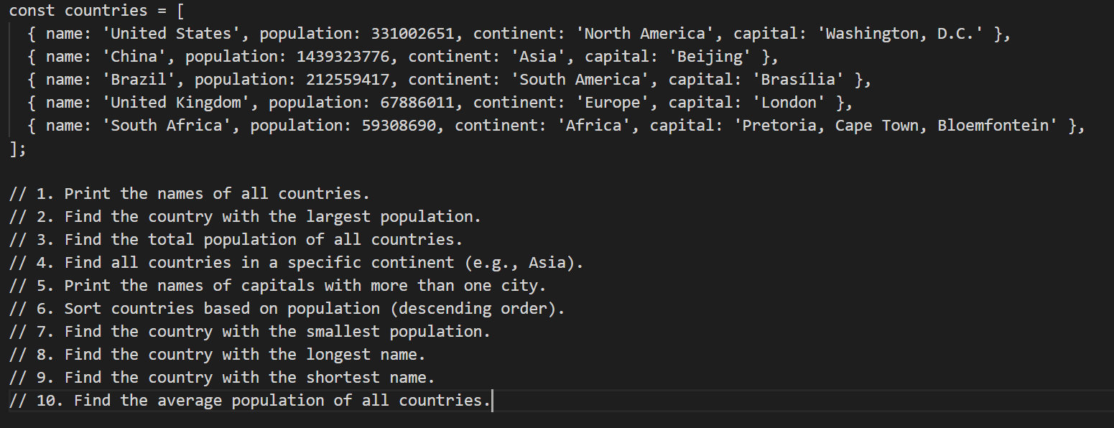
Task

